Slide 1
Quantum Computing
Tech-Arch DAY
2.10.2018
Hassan Naseri, PiNJA Kuosmanen

Slide 2
WELCOME! CONTECTS
Introduction to Quantum Computing
A Peek into Quantum Information Theory
Hello World! and Beyond
QISKIT and OpenQASM
Introduction to Quantum Algorithms
Conclusions

Slide 3
What is QUANTUM Computing?
The information is stored in a quantum system.
The computation/logic is governed by quantum-mechanical phenomena, such as superposition and entanglement.
Quantum information theory provides foundations for quantum computing.
Notes:
The convectional technology of silicon chips is already governed by quantum physics, but the computation is classic.
Quantum information systems (QIS) is different from quantum computing.
Quantum computer does not run classical algorithms on a quantum hardware. The computation method is fundamentally different form classical computing, e.g. your laptop computer is more similar to human brain than to a quantum computer.

Slide 4
TWO MAIN TECHNOLOGIES
Quantum Annealing Computer
Also known as adiabatic quantum computation (E.g. DWAVE).
Approximate answers to optimization problems.
Not a universal computer, hence cannot run standard quantum algorithms.
Universal Quantum Computer
Can solve any classical or quantum algorithm (E.g. IBM, Google).
Quantum Gate Model / Quantum Circuit.
Provides quantum speedup for certain algorithms developed.

Slide 5
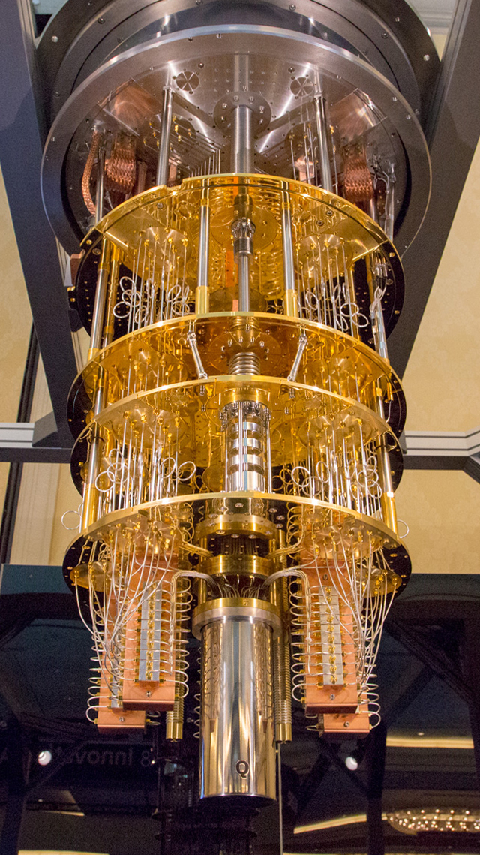
IBM Q System SUPERCONDUCTING CHIPS
IBM Q Experience
A public platform for quantum computing experiments, access to quantum computers, simulators, tools (circuit composer), API, etc.
Public computers: 5 and 16 qubit
Non-public computers: 20 qubit now, 50 qubit soon!
Programming SDK (QISKIT) and open source libraries
Technology
Superconducting chips
Dilution refrigerator : operating at 10 milliKelvin.
Noisy Intermediate-Scale Quantum (NISQ) technology
A sophisticated refrigerator

Slide 6
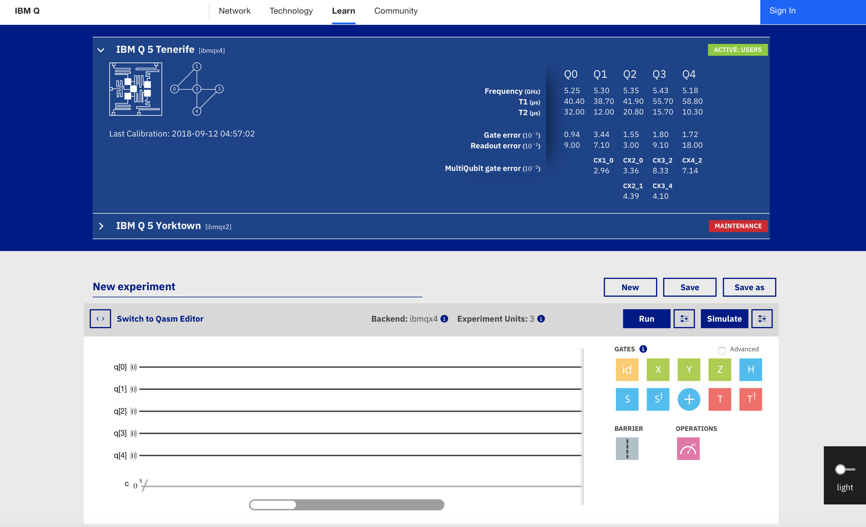
Different programming options for IBM Q system
Graphical interface (IBM Q – Composer)
OpenQASM
Open Quantum Assembly Language
Qiskit (Python SDK)
Qiskit-Aqua (Python library)

Slide 7

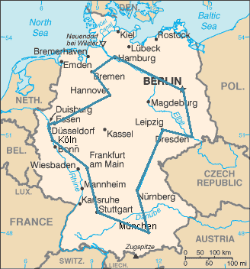
It is all about Complexity! NOT PERFORMANCE
Computation resources: space and time
The difference in complexity can make a problem intractable.
There are many intractable problems (usually approximated!)
Example:
A UPS truck has to deliver 400 packets in Helsinki. The TSP has complexity O(2⁴⁰⁰)
A quantum computer is not generally faster or parallel.
A qubit does not always store more information than a bit.
Quantum speedup
There are problems which are classically hard and quantumly easy!
Quantum speedup requires the existence of a corresponding quantum algorithm.
An optimal traveling salesperson tour through Germany’s 15 largest cities. It is the shortest among 43,589,145,600 possible tours visiting each city once.

Slide 8
Quantum Algorithms
The space of a quantum system grows exponentially.
Three categories of quantum algorithms:
Quantum Fourier transform (QFT) (exponential speedups)
Shor's algorithm: factorization of prime numbers
Quantum algorithm for linear systems of equation
Amplitude amplification (quadratic speedups)
Grover's algorithm: searches an unstructured database
uantum walks
It is difficult to design a new Quantum algorithm!
OTHER AREAS (NOT GATE MODEL)
Quantum simulation (Chemistry/Physics simulator)
Approximation algorithms
Quantum Communication

Slide 9
CONTECTS
Introduction to Quantum Computing
A Peek into Quantum Information Theory
Hello World! and Beyond
QISKIT and OpenQASM
Grover’s Algorithm - Setup
Conclusions

Slide 10
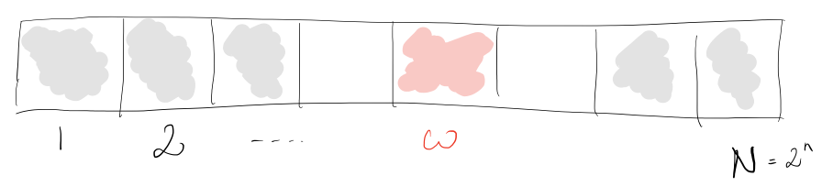
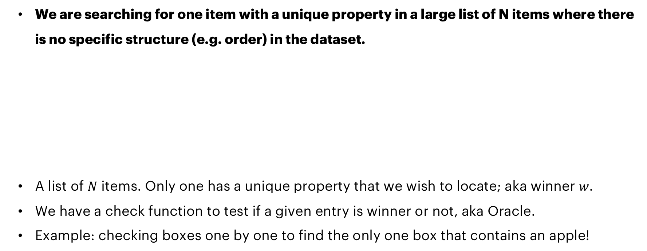
PROBLEM SETUP UNSTRUCTURED DATABASE SEARCH
We are searching for one item with a unique property in a large list of N items where there is no specific structure (e.g. order) in the dataset.
A list of $N$ items. Only one has a unique property that we wish to locate; aka winner $w$.
We have a check function to test if a given entry is winner or not, aka Oracle.
Example: checking boxes one by one to find the only one box that contains an apple!
Notes:
Later on, we will implement a database search algorithm, which is one of the rare algorithms that actually is proven to have quantum speedup
So, there is a list or set of items, one has unique property, and we will call it the winner ( what we want to find from the database)
First, we want to know, how to implement a checking mechanism or function that will tell us if an item was the winner or not
We will call this function ”the oracle” but you can treat it as a checking mechanism or even an if-condition if that help

Slide 11
A Classical Example UNSTRUCTURED DATABASE SEARCH
Find code in GitHub or in myBinder
https://github.com/HassanNaseri/quantum-computing-handson
https://mybinder.org/v2/gh/HassanNaseri/quantum-computing-handson/master
Open the Jupyter Notebook file: search_classic.ipynb
You can run Jupyter Notebook files cell by cell.
The goal is to find the shelf number for a given fruit name
We have access to black_box_check(key, value) function.
black_box_check(key, value)
arguments
key: string
value: 4-bit uint
return
NOT(value) if value=winner
value otherwise

Slide 12
A Classical Example UNSTRUCTURED DATABASE SEARCH
Task 1: Complete the code by giving value to
Maximum_number_of_steps =
Task 2: Complete the code by writing the second for loop
Same loop as before except for using random_indices in the for statement.
How many iterations are needed in average?
black_box_check(key, value)
arguments
key: string
value: 4-bit uint
return
NOT(value) if value=winner
value otherwise

Slide 13
CONTECTS
Introduction to Quantum Computing
A Peek into Quantum Information Theory
Hello World! and Beyond
QISKIT and OpenQASM
Grover’s Algorithm – Overall
Conclusions

Slide 14
QISKIT
What is QISKIT?
QISKIT (Quantum Information Science Kit) is an open-source quantum computing framework
A Python SDK
Backends: IBM Q computers, local and remote simulators
The starting point for writing code is the QuantumCircuit.
Circuits are collections of ClassicalRegister objects, QuantumRegister objects and gates. Through the top-level functions, the circuits can be sent to remote quantum devices or local simulator backends and collect the results for further analysis.
Documentation:
https://qiskit.org/documentation/quickstart.html
SDK ref.: https://qiskit.org/documentation/_autodoc/qiskit.html
Notes:
A python SDK for building quantum circuits
Possible to simulate locally or run on IBM backend

Slide 15
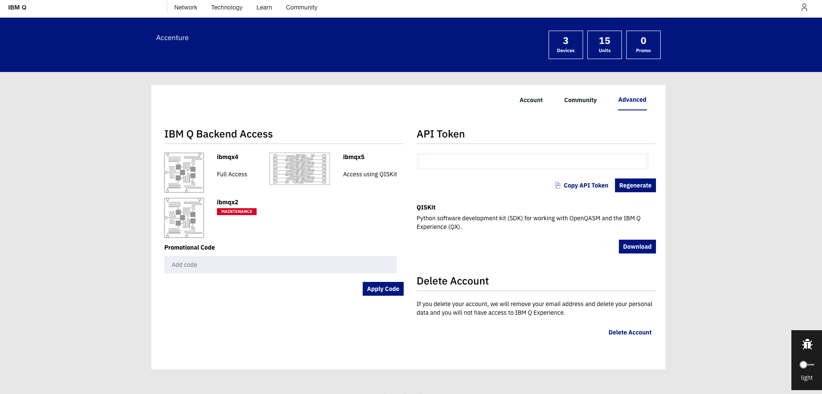
Create an IBM Q account and Get your token
Navigate to: https://quantumexperience.ng.bluemix.net/qx/editor
Click “sign in”
Choose your favorite identity provider and login
Navigate to: https://quantumexperience.ng.bluemix.net/qx/account/advanced
(Account → Advanced)
Copy your API token, you will need it for executing experiments from Qiskit
Your token

Slide 16
QISKIT InstallATIOn Spyder
Navigate to
https://mybinder.org/v2/gh/HassanNaseri/quantum-computing-handson/master
Open file: hello_qiskit.ipynb
Registring your credentials
Needs API Token and the QX URL.
Needs to be done only once.
Import the Qiskit SDK
QX_TOKEN = "728624125ddfb3acc6485060d3c3bbd63e8c1373e65b3e8d1f29fd91417c75f7efa60cccd73f17669da651e24669c8a2865e7c1fcefc01a3879dd5c735003244"
QX_URL = "https://quantumexperience.ng.bluemix.net/api"
from qiskit import register
register(QX_TOKEN, QX_URL)
from qiskit import QuantumCircuit, ClassicalRegister, QuantumRegister
from qiskit import available_backends, execute

Slide 17
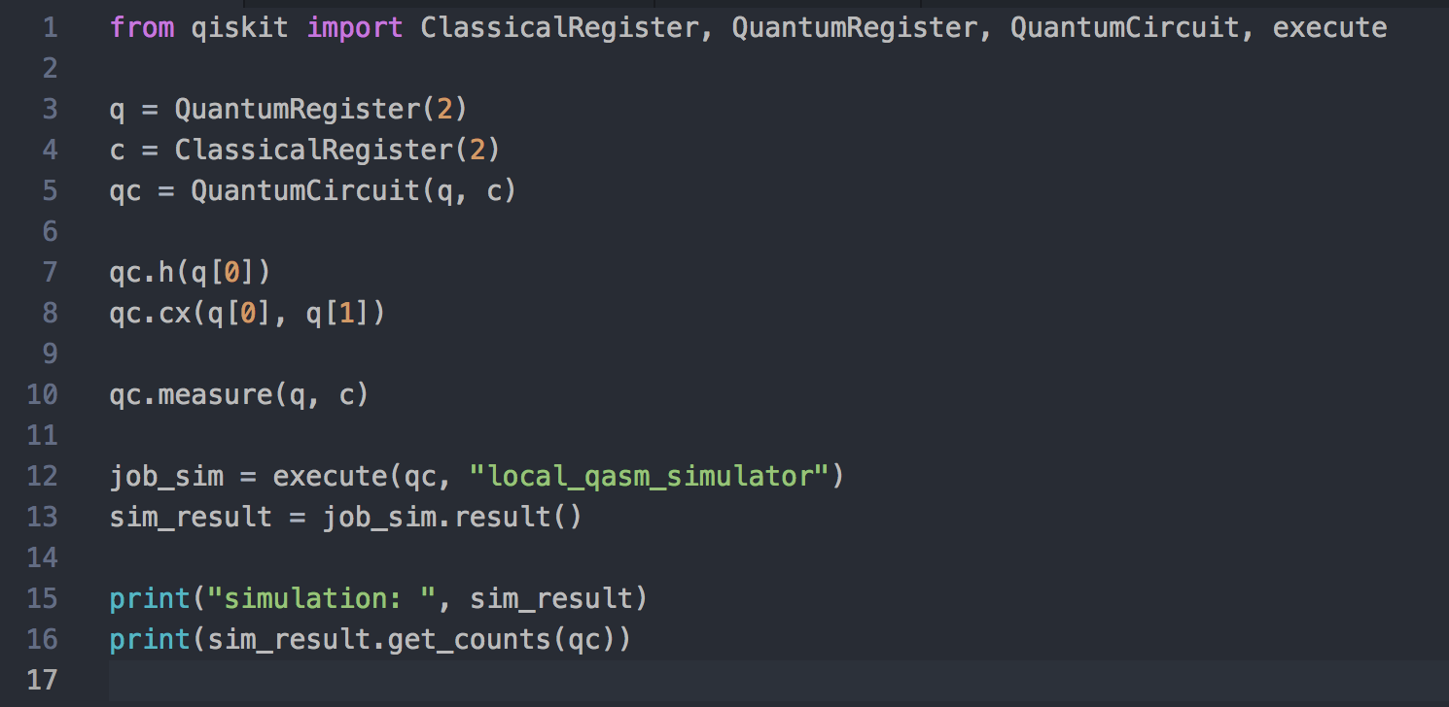
QISKIT
How does it look like?
Initialize a quantum register of 2 qubits and classical register of 2 bits
Initialize a quantum circuit (imagine the circuit in the graphical tool)
Add one Hadamard gate for q[0] and one CNOT-gate between q[0] and q[1]
Measure output and use local simulator as the backend option
print(”Available backends: ", available_backends())
Notes:
Simple gates but also extensions for more complex gates
Its possible to combine normal python code and qiskit code, the classical part will run on classical computer and quantum circuit will be executed on the quantum backend

Slide 18
CONTECTS
Introduction to Quantum Computing
A Peek into Quantum Information Theory
Hello World! and Beyond
QISKIT and OpenQASM
Grover’s Algorithm – Overall
Conclusions

Slide 19
CONTECTS
Introduction to Quantum Computing
A Peek into Quantum Information Theory
Hello World! and Beyond
QISKIT and OpenQASM
Grover’s Algorithms
Conclusions

Slide 20
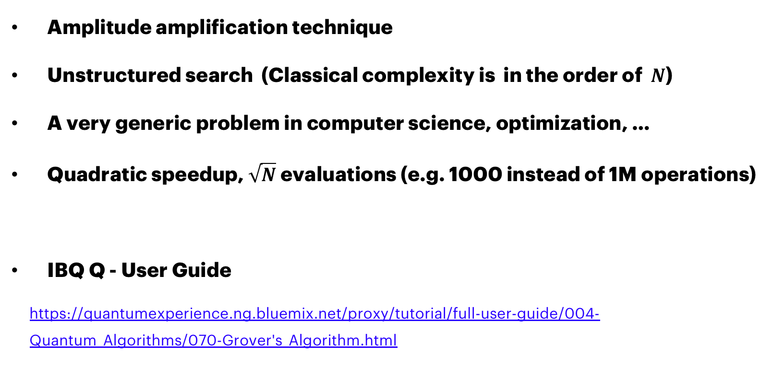
Grover’s Algorithm
Amplitude amplification technique
Unstructured search (Classical complexity is in the order of $N$)
A very generic problem in computer science, optimization, …
Quadratic speedup, $\sqrt{N}$ evaluations (e.g. 1000 instead of 1M operations)
IBQ Q - User Guide
https://quantumexperience.ng.bluemix.net/proxy/tutorial/full-user-guide/004-Quantum_Algorithms/070-Grover's_Algorithm.html

Slide 21
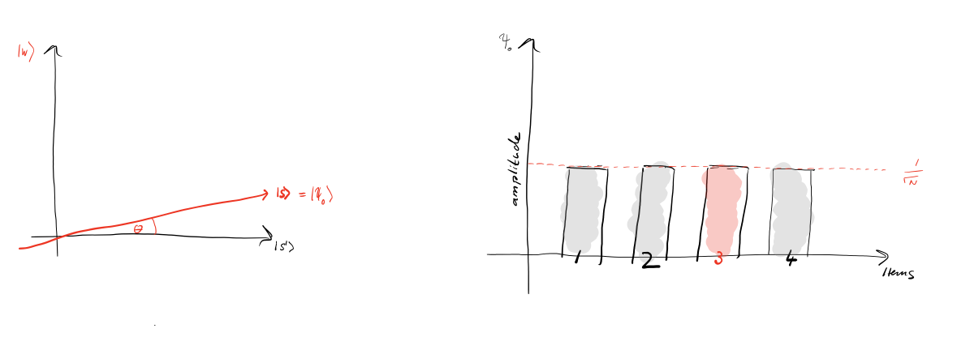
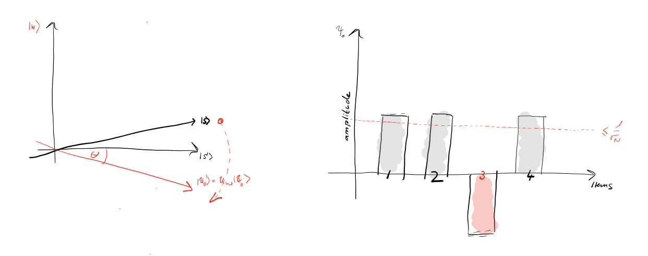
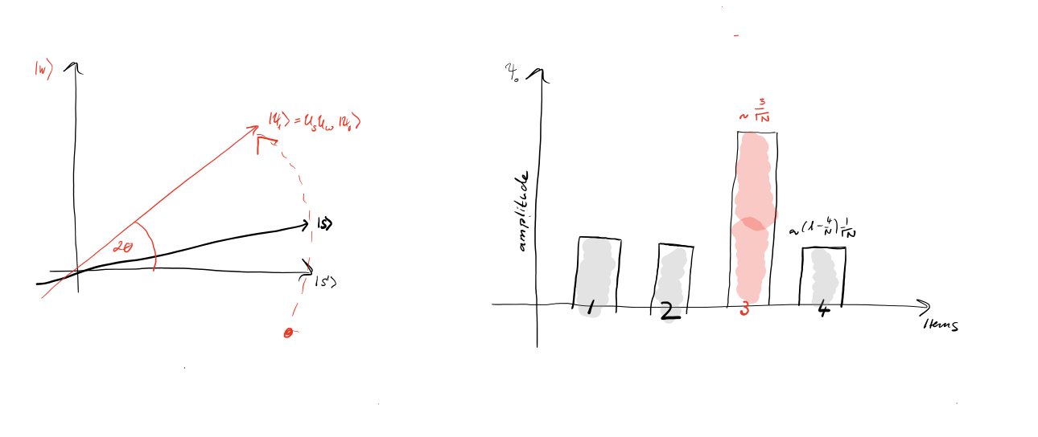
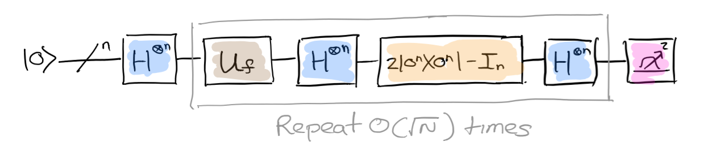
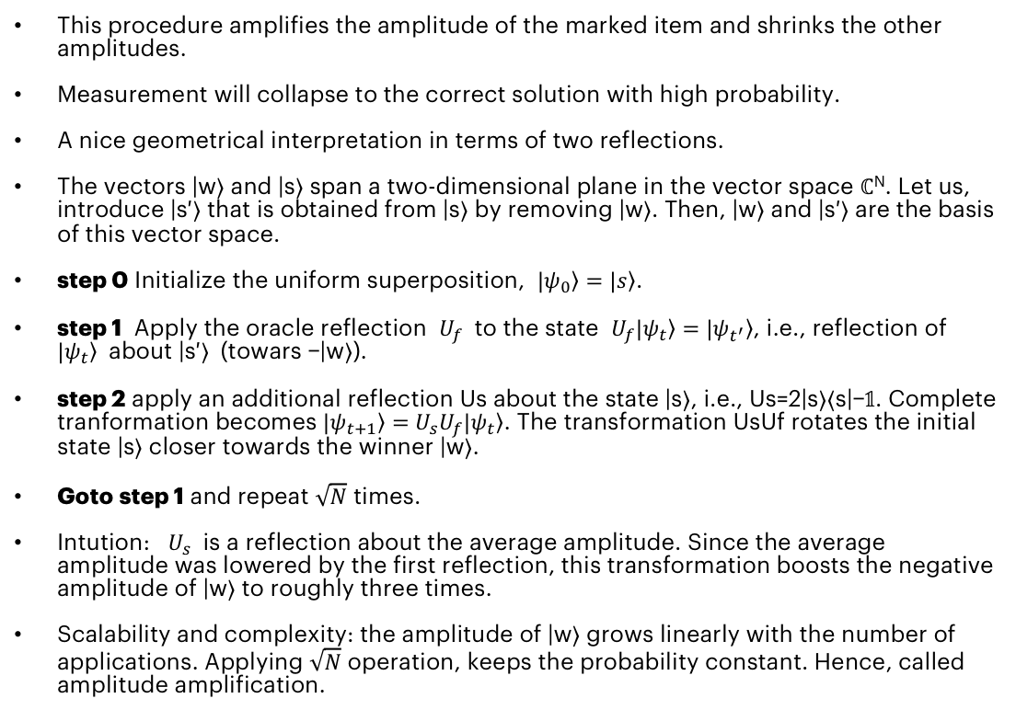
GROVER’s: Amplitude Amplification reflection about the AVERAGE
This procedure amplifies the amplitude of the marked item and shrinks the other amplitudes.
Measurement will collapse to the correct solution with high probability.
A nice geometrical interpretation in terms of two reflections.
The vectors |w⟩ and |s⟩ span a two-dimensional plane in the vector space ℂ^{N}. Let us, introduce |s′⟩ that is obtained from |s⟩ by removing |w⟩. Then, |w⟩ and |s′⟩ are the basis of this vector space.
step 0 Initialize the uniform superposition, $|\left.ψ_{0}\right\rangle =|\left.s\right\rangle$.
step 1 Apply the oracle reflection $U_{f}$ to the state $U_{f}|\left.ψ_{t}\right\rangle =$ $|\left.ψ_{t^{′}}\right\rangle$, i.e., reflection of $|\left.ψ_{t}\right\rangle$ about |s′⟩ (towars −|w⟩).
step 2 apply an additional reflection Us about the state |s⟩, i.e., Us=2|s⟩⟨s|−𝟙. Complete tranformation becomes $|\left.ψ_{t+1}\right\rangle =$ $U_{s}U_{f}|\left.ψ_{t}\right\rangle$. The transformation UsUf rotates the initial state |s⟩ closer towards the winner |w⟩.
Goto step 1 and repeat $\sqrt{N}$ times.
Intution: $U_{s}$ is a reflection about the average amplitude. Since the average amplitude was lowered by the first reflection, this transformation boosts the negative amplitude of |w⟩ to roughly three times.
Scalability and complexity: the amplitude of |w⟩ grows linearly with the number of applications. Applying $\sqrt{N}$ operation, keeps the probability constant. Hence, called amplitude amplification.

Slide 22
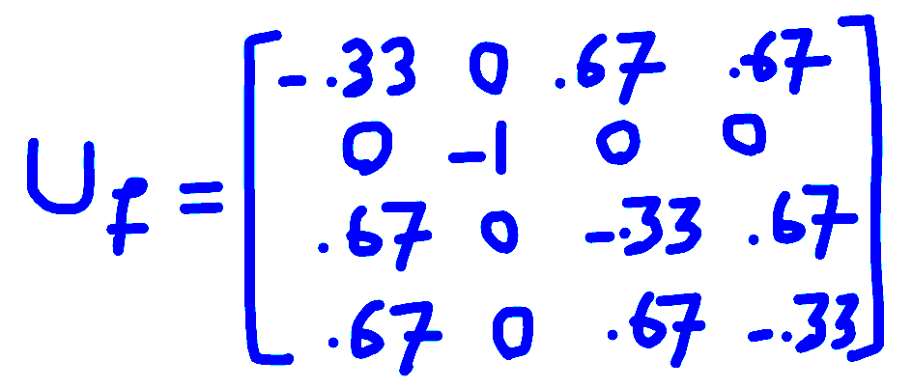
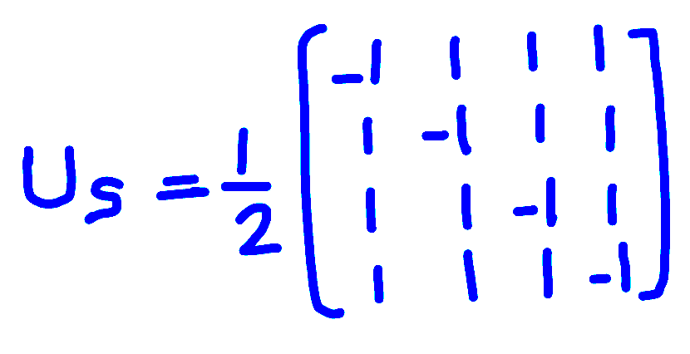
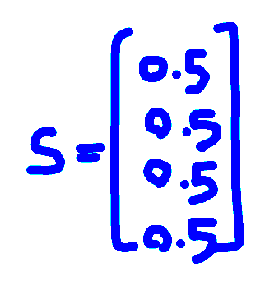
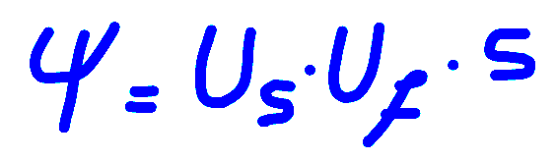
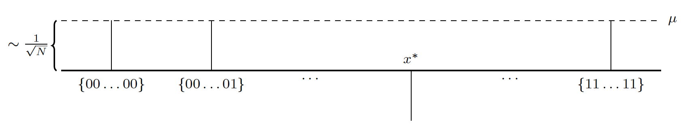
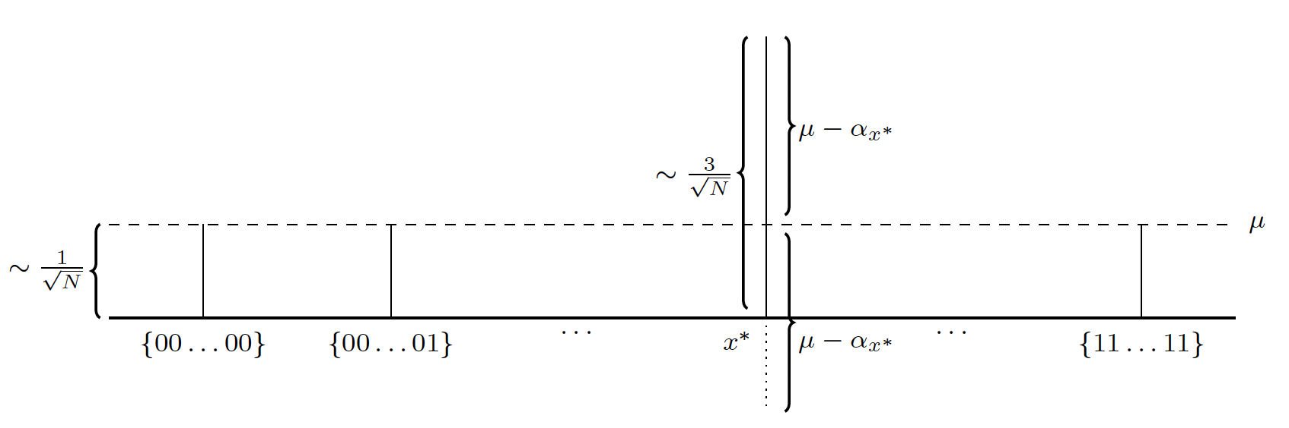
If curious, simulate yourself in python or do it on paper!
﻿import numpy as np
import numpy.linalg as la
# Print setting for arrays
np.set_printoptions(formatter={'float': '{: 0.2f}'.format})
# The winner state to find.
w = np.array([0, 1, 0, 0])
N = len(w)
print("w: {:}".format(w))
# Unifrom superosition, prior state
s = (1/np.sqrt(N)) * np.ones(N)
# Find unit vector |sp> as a component of |s> orthogonal to |w>
sp = (s - w.dot(s)*w)
sp = sp/la.norm(sp)
print("sp: {:}".format(sp))
# Reflection about sp (inversion)
Uf = np.array(2*np.outer(sp,sp) - np.eye(N))
print("Uf: {:}".format(Uf))
# Reflection about s (about average)
Us = np.array(2*np.outer(s,s)-np.eye(N))
print("Us: {:}".format(Us))
Psi2 = Uf.dot(s)
print("Uf.s: {:}".format(Psi2))
result = Us.dot(Psi2)
print("Result: {:}".format(result))

Slide 23
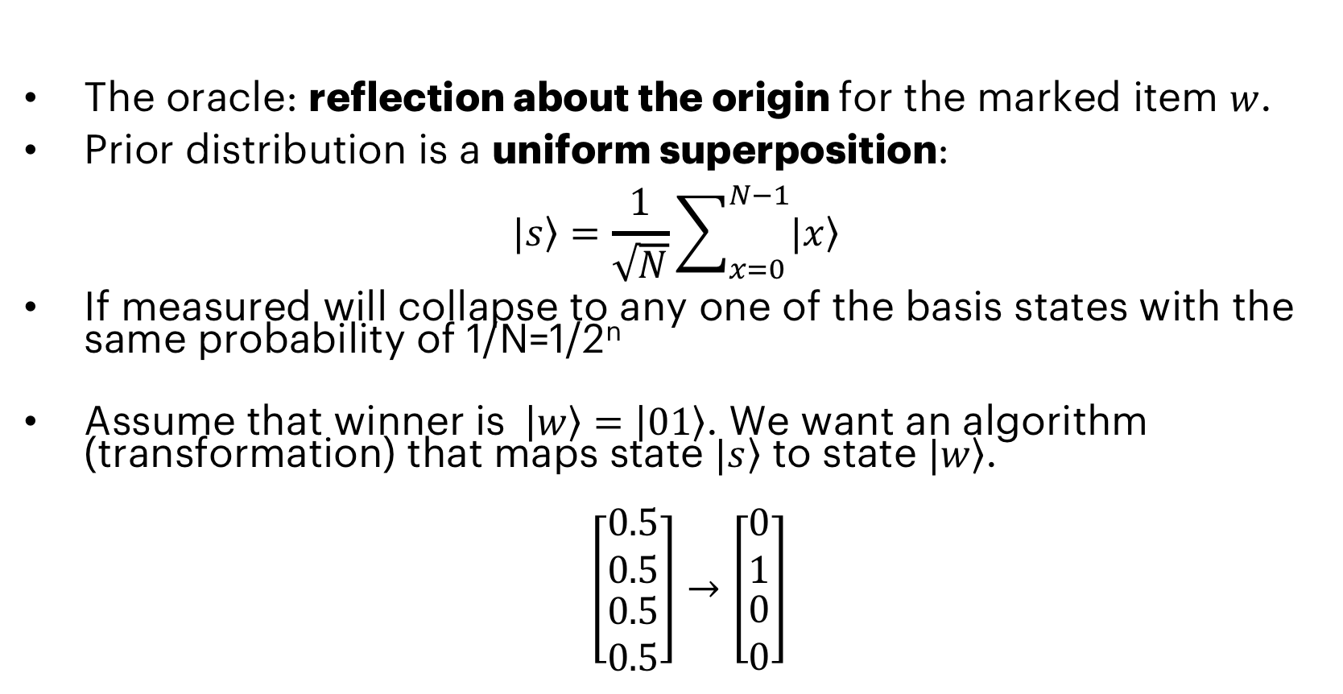
GROVER’S: Providing the List (Function) The ORACLE
The oracle: reflection about the origin for the marked item $w$.
Prior distribution is a uniform superposition:
$$|\left.s\right\rangle =\frac{1}{\sqrt{N}}\sum_{x=0}^{N−1}{|\left.x\right\rangle }$$
If measured will collapse to any one of the basis states with the same probability of 1/N=1/2^{n}
Assume that winner is $\left|\left.w\right\rangle \right.=\left|\left.01\right\rangle \right.$. We want an algorithm (transformation) that maps state $|\left.s\right\rangle$ to state $|\left.w\right\rangle$.
$\left[\begin{matrix}0.5 \\ 0.5 \\ \begin{aligned}0.5 \\ 0.5\end{aligned}\end{matrix}\right]→\left[\begin{matrix}0 \\ 1 \\ \begin{aligned}0 \\ 0\end{aligned}\end{matrix}\right]$

Slide 24
black_box_check(grover, fruit_to_find, qreg)
reflection_about_average(grover, qreg)

Slide 25
CONTECTS
Introduction to Quantum Computing
A Peek into Quantum Information Theory
Hello World! and Beyond
QISKIT and OpenQASM
Introduction to Quantum Algorithms
Conclusions

Slide 26
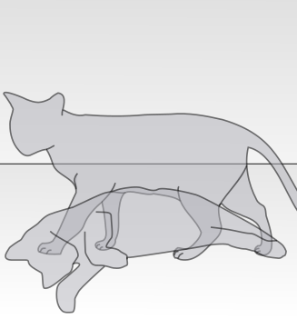
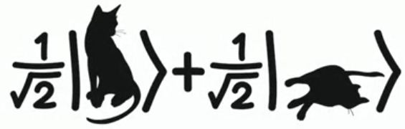
Something about Quantum Physics
Superposition, Collapse, Entanglement, Teleportation
The physics can be difficult and subject to different interpretations.
Mathematics are simple and do not require interpretation.
Two important laws:
Quantum operations are reversible.
Measurement is irreversible
Notes:
Example of linear combination

Slide 27
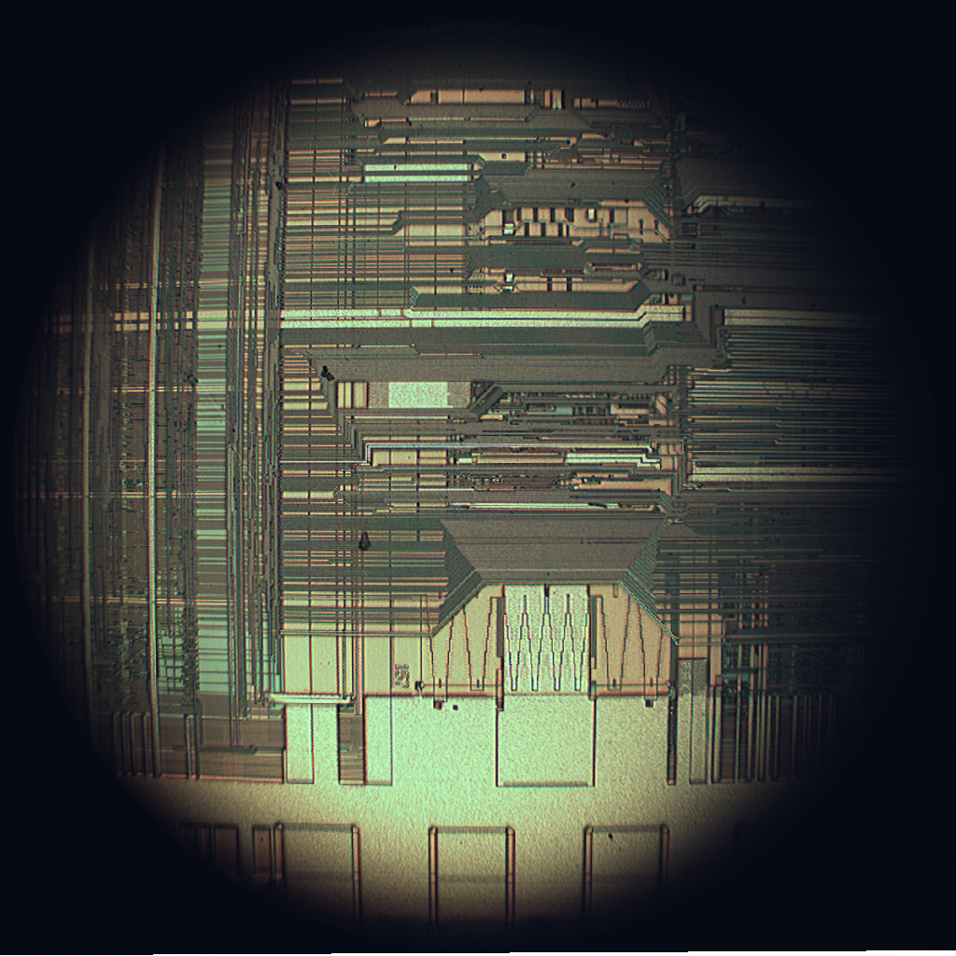
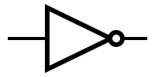
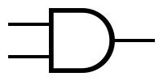
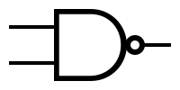

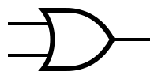


Review of CLASSICAL COMPUTING: MODERN DIGITAL COMPUTERS
Electronic: using electrons to process information
Digital: information units are bits (0/1)
Silicon-based transistor logic (MOSFET)
Basic gates: AND, OR, NAND, …
Universal gates: NAND, NOR
Most system use a single universal gate
Full adder made of NAND gates
Notes:
Finish approximately 12:40

Slide 28
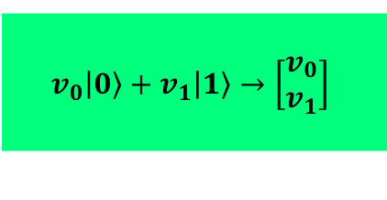
What is a QUBIT?
Left
The fundamental unit of quantum information.
Linear combination of two or more states.
Physical implementation can very, and there are different technologies.
Measurement: induces “collapse” in quantum state (to eigenvectors)
The vector representation of a single qubit:
Right
$$v_{0}\left|\left.0\right\rangle +v_{1}\right|\left.1\right\rangle →\left[\begin{matrix}v_{0} \\ v_{1}\end{matrix}\right]$$

Slide 29
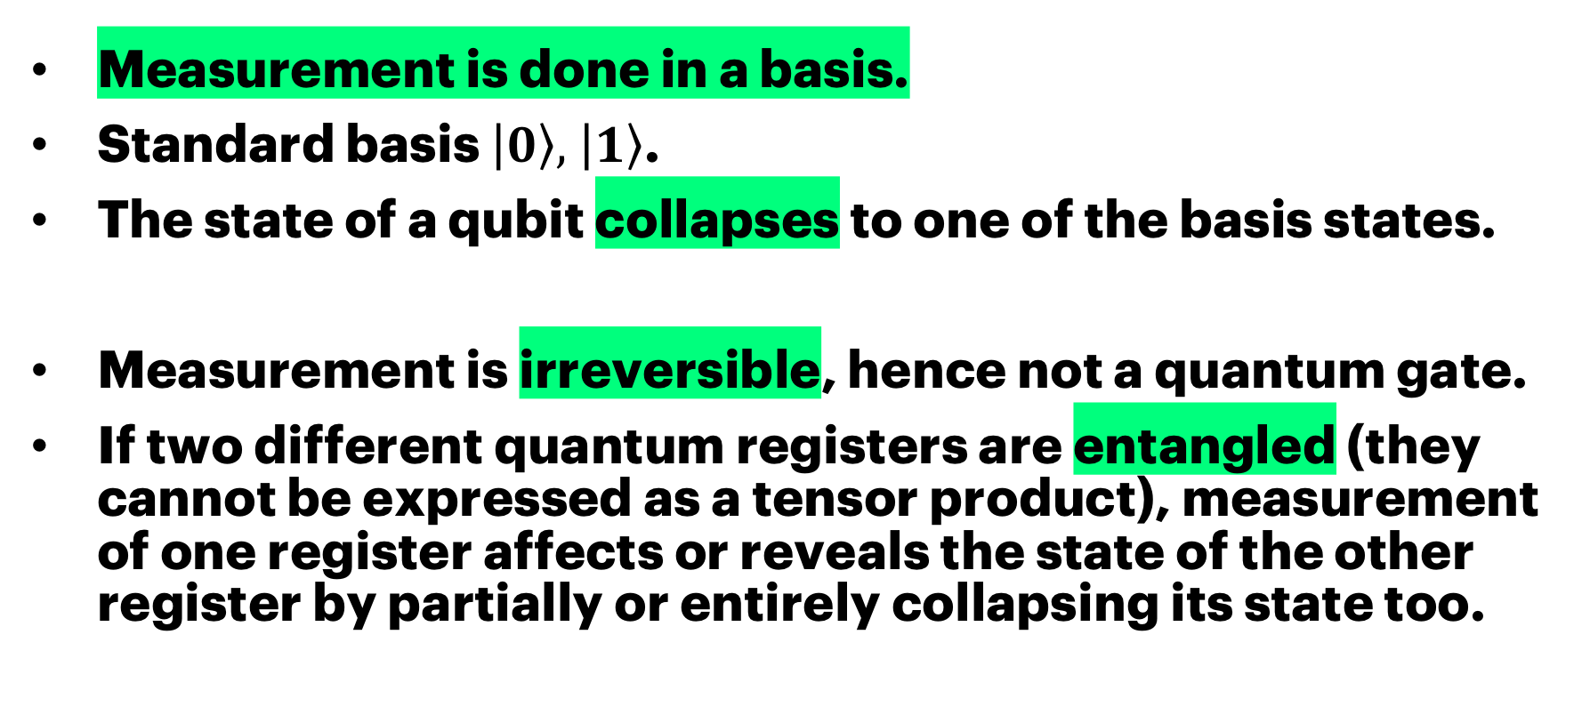
Measurement
Measurement is done in a basis.
Standard basis $\left|\left.0\right\rangle , \right|\left.1\right\rangle$.
The state of a qubit collapses to one of the basis states.
Measurement is irreversible, hence not a quantum gate.
If two different quantum registers are entangled (they cannot be expressed as a tensor product), measurement of one register affects or reveals the state of the other register by partially or entirely collapsing its state too.

Slide 30
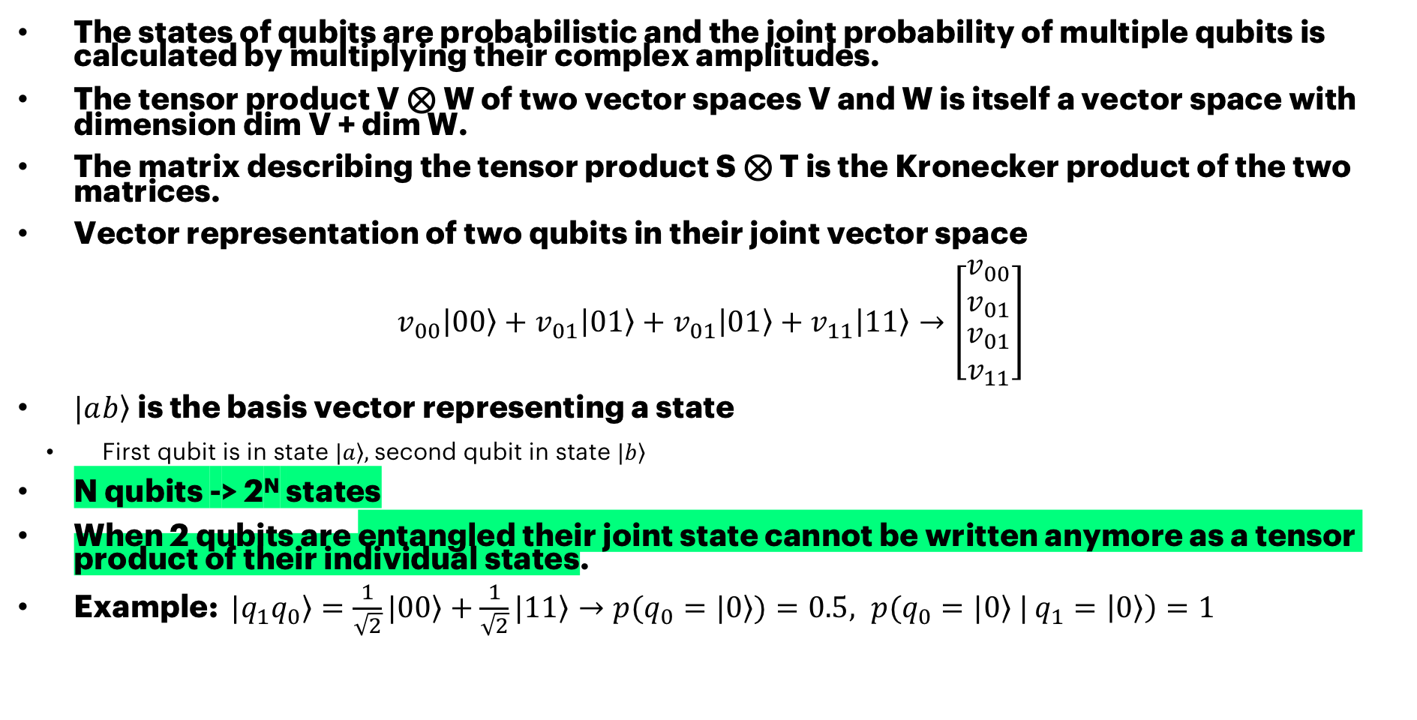
VECTOR SPACE AND ENTAGLEMENT
The states of qubits are probabilistic and the joint probability of multiple qubits is calculated by multiplying their complex amplitudes.
The tensor product V ⊗ W of two vector spaces V and W is itself a vector space with dimension dim V + dim W.
The matrix describing the tensor product S ⊗ T is the Kronecker product of the two matrices.
Vector representation of two qubits in their joint vector space
$$v_{00}\left|\left.00\right\rangle +v_{01}\right|0\left.1\right\rangle +v_{01}\left|\left.01\right\rangle +v_{11}\right|1\left.1\right\rangle →\left[\begin{matrix}v_{00} \\ v_{01} \\ \begin{aligned}v_{01} \\ v_{11}\end{aligned}\end{matrix}\right]$$
$|a\left.b\right\rangle$is the basis vector representing a state
First qubit is in state $\left.|a\right\rangle ,$second qubit in state $\left.|b\right\rangle$
N qubits -> 2^{N} states
When 2 qubits are entangled their joint state cannot be written anymore as a tensor product of their individual states.
Example: $|\left.q_{1}q_{0}\right\rangle =\frac{1}{\sqrt{2}}|\left.00\right\rangle +\frac{1}{\sqrt{2}}|1\left.1\right\rangle →p(q_{0}=|\left.0\right\rangle )=0.5, p(q_{0}=|\left.0\right\rangle |$ $q_{1}=\left|\left.0\right\rangle \right)=1$

Slide 31
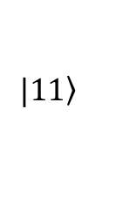
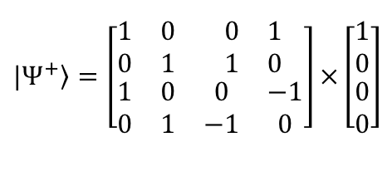
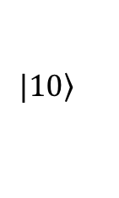
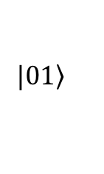
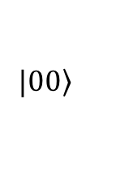
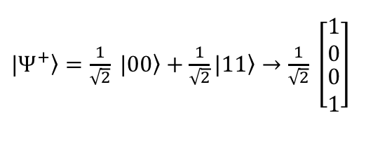
Quantum Information THEORY
Bell states:
Quantum states of two qubits that represent the simplest examples of quantum entanglement (known as an EPR pair).
Algebraic representation:
Quantum computation is done using quantum mechanics operation.
Operations are unitary transformations (preserves the inner product).
Operations can be performed/represented using linear algebra.
Each operation (or the whole process) has unitary matrix.
The vectors/matrices are complex-valued.
$$\left.|00\right\rangle$$
$\left.{|Ψ}^{+}\right\rangle =\frac{1}{\sqrt{2}} \left.|00\right\rangle +\frac{1}{\sqrt{2}}|\left.11\right\rangle →$ $\frac{1}{\sqrt{2}} \left[\begin{matrix}\begin{matrix}1 \\ 0\end{matrix} \\ \begin{matrix}0 \\ 1\end{matrix}\end{matrix}\right]$
$$\left.|01\right\rangle$$
$$\left.|10\right\rangle$$
$$\left.|11\right\rangle$$
$$|\left.Ψ^{+}\right\rangle =\left[\begin{matrix}\begin{matrix}1 & 0 \\ 0 & 1\end{matrix} & \begin{matrix}0 & 1 \\ 1 & 0\end{matrix} \\ \begin{matrix}1 & 0 \\ 0 & 1\end{matrix} & \begin{matrix}0 & −1 \\ −1 & 0\end{matrix}\end{matrix}\right]×\left[\begin{matrix}\begin{matrix}1 \\ 0\end{matrix} \\ \begin{matrix}0 \\ 0\end{matrix}\end{matrix}\right]$$

Slide 32
Quantum Gate Model HOW DOES A UNIVERSAL QUANTUM COMPUTER WORK?
A universal quantum computer made form simple gates.
Most common gates: 1-qubit and 2-qubit gates
Quantum logic gates are reversible.
Quantum logic gates are represented by unitary matrices.
The state of a qubit is not known before measurement.
The base vectors are the only possible outcomes if measured, not the actual amplitudes.
Due to this inherent randomness (and also noise), the process is repeated and measured many times to find the probabilities of each state.

Slide 33
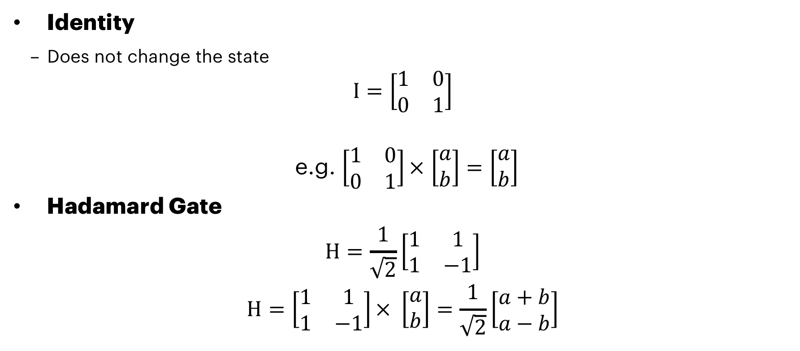
IDENTITY Hadamard GAteS
Identity
Does not change the state
$$I=\left[\begin{matrix}1 & 0 \\ 0 & 1\end{matrix}\right]$$
e.g. $\left[\begin{matrix}1 & 0 \\ 0 & 1\end{matrix}\right]×$ $\left[\begin{matrix}a \\ b\end{matrix}\right]=\left[\begin{matrix}a \\ b\end{matrix}\right]$
Hadamard Gate
$$H=\frac{1}{\sqrt{2}}\left[\begin{matrix}1 & 1 \\ 1 & −1\end{matrix}\right]$$
$$H=\left[\begin{matrix}1 & 1 \\ 1 & −1\end{matrix}\right]× \left[\begin{matrix}a \\ b\end{matrix}\right]=\frac{1}{\sqrt{2}}\left[\begin{matrix}a+b \\ a−b\end{matrix}\right]$$
I
H

Slide 34
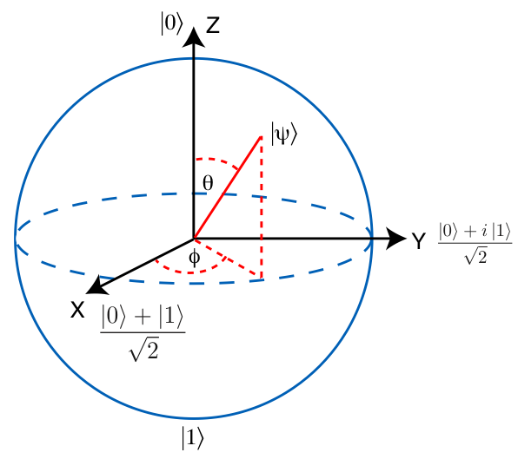
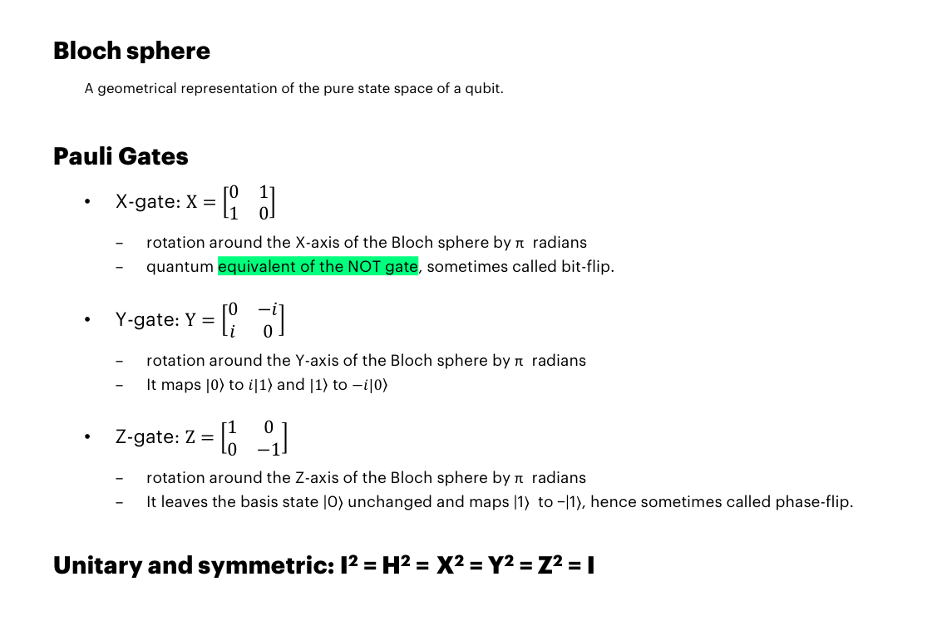
Bloch Sphere and Pauli gates
Bloch sphere
A geometrical representation of the pure state space of a qubit.
Pauli Gates
X-gate: $X=\left[\begin{matrix}0 & 1 \\ 1 & 0\end{matrix}\right]$
rotation around the X-axis of the Bloch sphere by π radians
quantum equivalent of the NOT gate, sometimes called bit-flip.
Y-gate: $Y=\left[\begin{matrix}0 & −i \\ i & 0\end{matrix}\right]$
rotation around the Y-axis of the Bloch sphere by π radians
It maps $\left.|0\right\rangle$ to $\left.i|1\right\rangle$ and $\left.|1\right\rangle$ to $\left.−i|0\right\rangle$
Z-gate: $Z=\left[\begin{matrix}1 & 0 \\ 0 & −1\end{matrix}\right]$
rotation around the Z-axis of the Bloch sphere by π radians
It leaves the basis state |0⟩ unchanged and maps |1⟩ to −|1⟩, hence sometimes called phase-flip.
Unitary and symmetric: I² = H² = X² = Y² = Z² = I
X
Y
Z

Slide 35
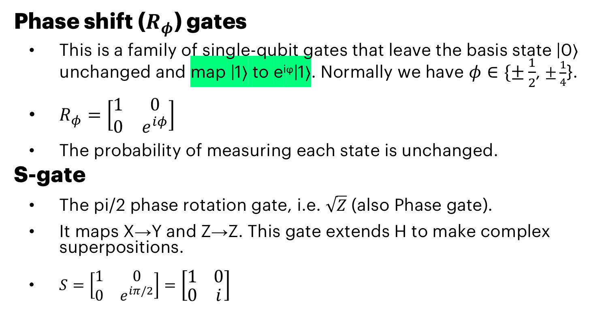
Phase SHIFT GATES
Phase shift ($R_{φ}$) gates
This is a family of single-qubit gates that leave the basis state |0⟩ unchanged and map |1⟩ to e^{iϕ}|1⟩. Normally we have $φ∈\{±\frac{1}{2}$, $±\frac{1}{4}$}.
$R_{φ}=\left[\begin{matrix}1 & 0 \\ 0 & e^{iφ}\end{matrix}\right]$
The probability of measuring each state is unchanged.
S-gate
The pi/2 phase rotation gate, i.e. $\sqrt{Z}$ (also Phase gate).
It maps X→Y and Z→Z. This gate extends H to make complex superpositions.
$S=\left[\begin{matrix}1 & 0 \\ 0 & e^{iπ/2}\end{matrix}\right]=\left[\begin{matrix}1 & 0 \\ 0 & i\end{matrix}\right]$
S
Z^{1/2}

Slide 36
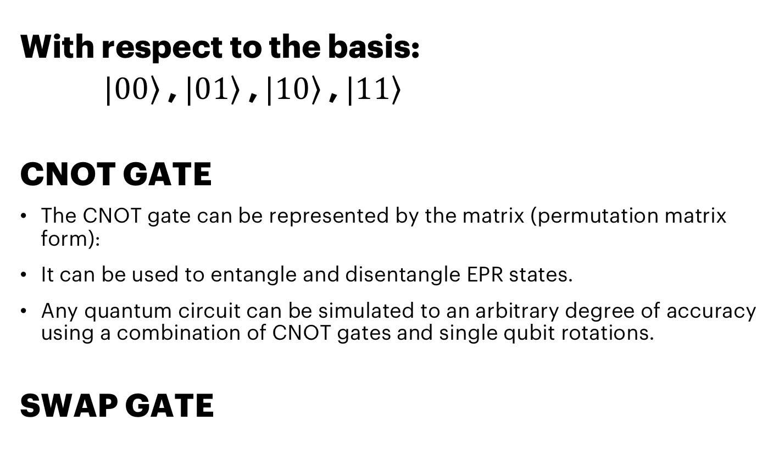
TWO-Qubit gates
With respect to the basis:
$|0\left.0\right\rangle$, $|0\left.1\right\rangle$, $|1\left.0\right\rangle$, $|1\left.1\right\rangle$
CNOT GATE
The CNOT gate can be represented by the matrix (permutation matrix form):
It can be used to entangle and disentangle EPR states.
Any quantum circuit can be simulated to an arbitrary degree of accuracy using a combination of CNOT gates and single qubit rotations.
SWAP GATE

Slide 37
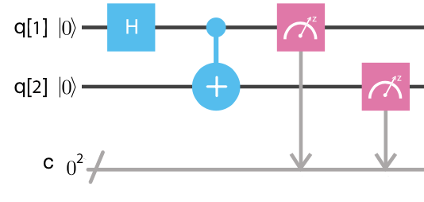
QUANTUM CIRCUITS SUPERPOSITION, ENTAGLEMENT, INTERFERENCE, COLLAPSE
Bell states
The first Bell state can be created using a Hadamard gate and a CNOT gate.
Measurement of one qubit will assign one of two possible values to the other qubit instantly.
Notes:
Finish approximately 13:50

Slide 38
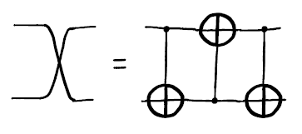
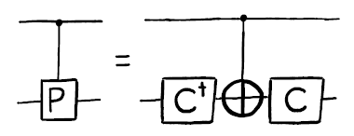
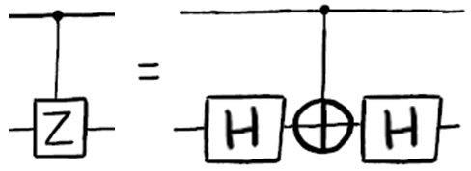
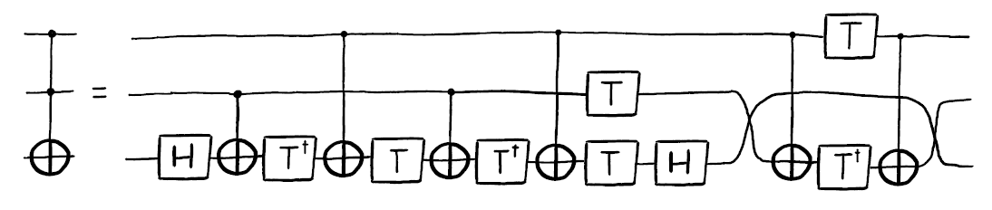
Basic Circuit Identities and Larger Circuits (IBM Q Experience User Guide)
Swapping the states of qubits
Adding a control qubit to a gate
Example: Controlled Z-gate
controlled-Hadamard operation
Toffoli (CCNOT)
Notes:
All the simple gates are available in composer and qiskit, but the more complex ones are not in composer
It is good to know how they can be build from the simple gates
Qiskit has some extensions, where these are available
If somebody is more comfortable with the matrices than the gates and circuits → Show how controlled Z-gate is constructed from matrices
IH x XC x IH

Slide 39
CONTECTS
Introduction to Quantum Computing
A Peek into Quantum Information Theory
Hello World! and Beyond
QISKIT and OpenQASM
The Oracle
Conclusions

Slide 40
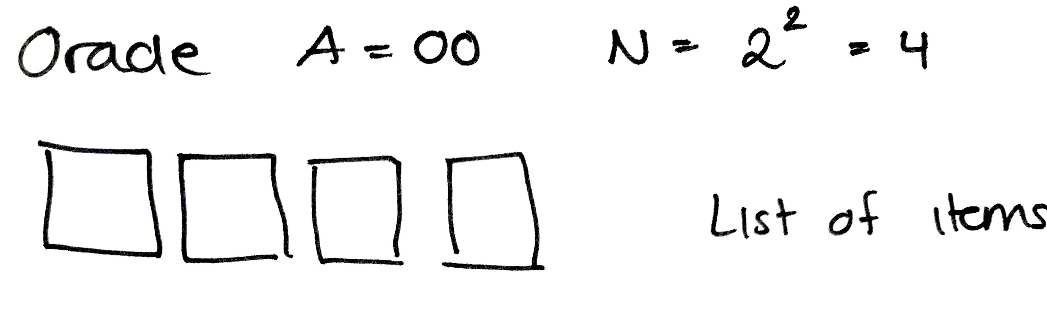
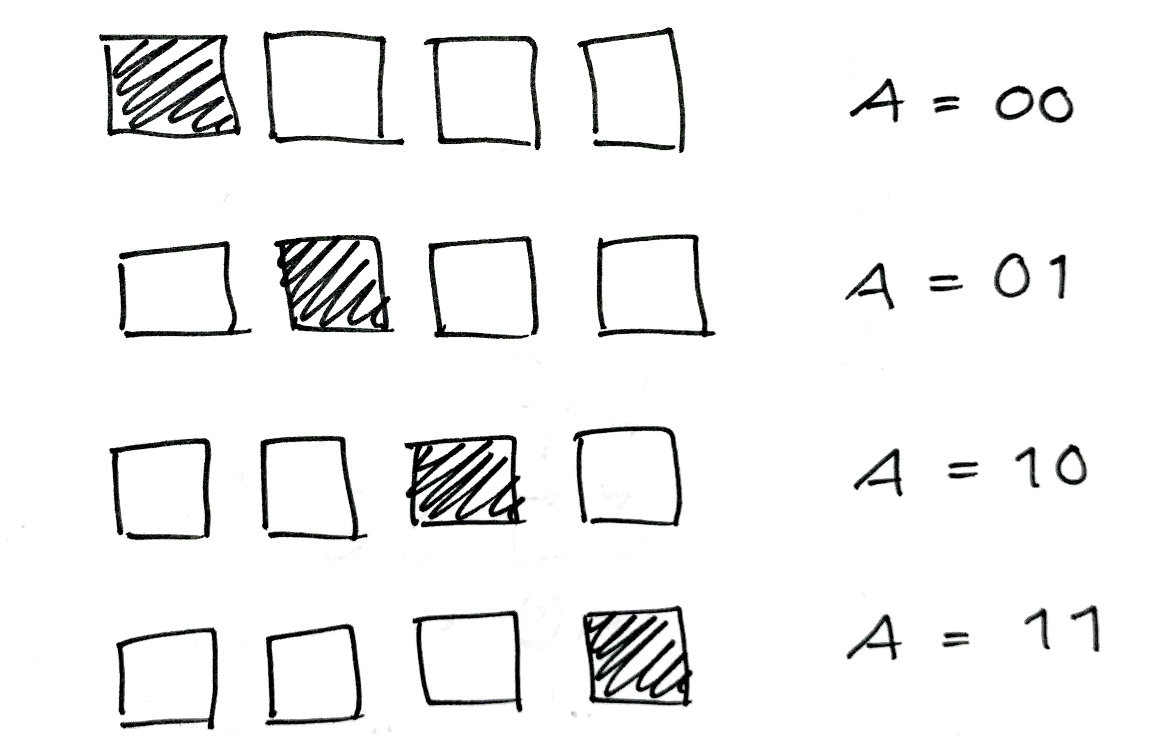
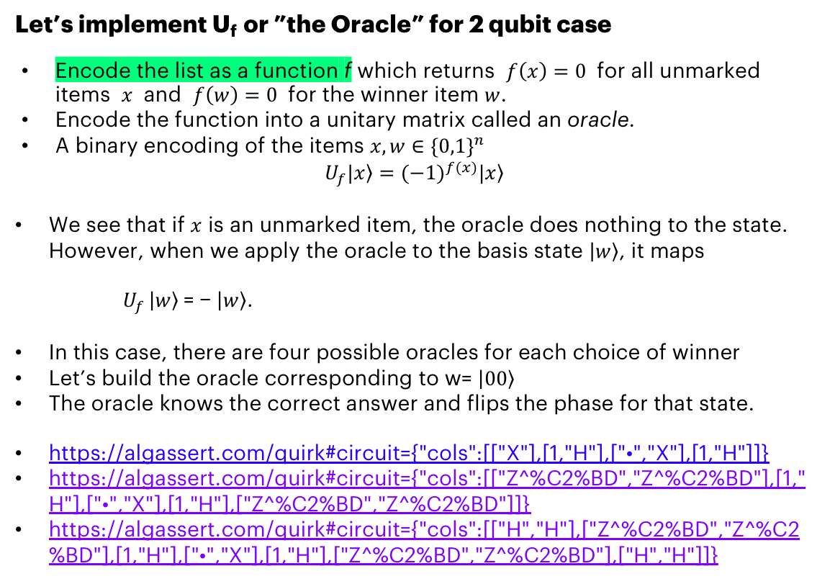
QISKIT Example: The Oracle How to encode a list of items in a quantum computer?
Let’s implement U_{f} or ”the Oracle” for 2 qubit case
Encode the list as a function f which returns $f\left(x\right)=0$ for all unmarked items $x$ and $f\left(w\right)=0$ for the winner item $w$.
Encode the function into a unitary matrix called an oracle.
A binary encoding of the items $x,w∈{\{0,1\}}^{n}$
$$U_{f}|\left.x\right\rangle ={(−1)}^{f(x)}|\left.x\right\rangle$$
We see that if $x$ is an unmarked item, the oracle does nothing to the state. However, when we apply the oracle to the basis state $\left|\left.w\right\rangle \right.$, it maps
$U_{f }\left|\left.w\right\rangle \right.$= − $\left|\left.w\right\rangle \right.$.
In this case, there are four possible oracles for each choice of winner
Let’s build the oracle corresponding to w= $\left|\left.00\right\rangle \right.$
The oracle knows the correct answer and flips the phase for that state.
https://algassert.com/quirk#circuit={"cols":[["X"],[1,"H"],["•","X"],[1,"H"]]}
https://algassert.com/quirk#circuit={"cols":[["Z^%C2%BD","Z^%C2%BD"],[1,"H"],["•","X"],[1,"H"],["Z^%C2%BD","Z^%C2%BD"]]}
https://algassert.com/quirk#circuit={"cols":[["H","H"],["Z^%C2%BD","Z^%C2%BD"],[1,"H"],["•","X"],[1,"H"],["Z^%C2%BD","Z^%C2%BD"],["H","H"]]}
Four possible Oracles:
Notes:
We will give the inputs to the oracle → it checks if this was the winner → it will swap the phase of the amplitude corresponding to the winner state
If statement of a database
Explain with binary initialization first, then superposition state.
This type of encoding is not the only way to do the check, but this particular way will be useful later

Slide 41
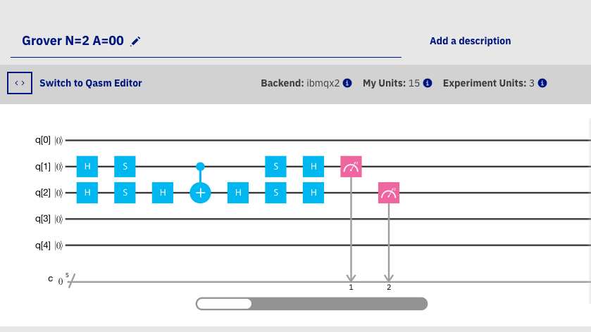
QISKIT Exercise: The Oracle How to encode a list of items?
Implement the above circuit in Qiskit.
The outcome should be a uniform distribution (the amplitudes cannot be masured).
Notes:
Explain that Hadamards are not part of the Oracle logic, but it is used to initialize the uniform distribution
No way to see the amplitudes here, but it is possible in Quirk if you would like to play around
Another way to see the amplitudes is to validate the logic via linear algebra → we will do this next

Slide 42

QISKIT Exercise: The Oracle (SOLUTION)
from qiskit import ClassicalRegister, QuantumRegister, QuantumCircuit, execute
# Initialize the circuit
q = QuantumRegister(5)
c = ClassicalRegister(5)
qc = QuantumCircuit(q, c)
# Add gates
qc.h(q[1])
qc.h(q[2])
qc.s(q[1])
qc.s(q[2])
qc.h(q[2])
qc.cx(q[1], q[2])
qc.h(q[2])
qc.s(q[1])
qc.s(q[2])
qc.h(q[1])
qc.h(q[2])
qc.measure(q, c)
job_sim = execute(qc, "local_qasm_simulator")
sim_result = job_sim.result()
print("simulation: ", sim_result)
print(sim_result.get_counts(qc))
Uniform distribution (the amplitudes are not shown here):
Notes:
Explain that Hadamards are not part of the Oracle logic, but it is used to initialize the uniform distribution
No way to see the amplitudes here, but it is possible in Quirk if you would like to play around
Another way to see the amplitudes is to validate the logic via linear algebra → we will do this next

Slide 43


TEST The Oracle LOGIC LINEAR ALGEBRA IN PYTHON
import numpy as np
q1 = np.array([[1,0]])
q2 = np.array([[1,0]])
# Some basic gates
I = np.array([[1,0],[0,1]])
H = (1/np.sqrt(2))*np.array([[1,1],[1,-1]])
X = np.array([[0,1],[1,0]])
Y = np.array([[0,-1j],[1j,0]])
Z = np.array([[1,0],[0,-1]])
S = np.array([[1,0],[0,1j]])
CX = np.array([[1,0,0,0],[0,1,0,0],[0,0,0,1],[0,0,1,0]])
# ------- start in a separate basis for each qubit -------
t1_0 = q1.dot(H).dot(S)
t1_1 = q2.dot(H).dot(S).dot(H)
# CNOT makes them entangled, there is no way to invert this (split
# them)
t2 = np.kron(t1_0, t1_1).dot(CX)
t3 = t2.dot(np.kron(I,H)).dot(np.kron(S,S)).dot(np.kron(H,H))
print('State \t|00⟩\t\t|01⟩\t\t|10⟩\t\t|11⟩')
print ('\t'+'\t'.join('{}'.format(i) for i in np.round(t3[0,:],2)))
Notes:
This is the code to validate the logic in python and see the amplitudes
You can also do it in pen and paper (it’s fun to do maybe once)

Slide 44


TEST The Oracle LOGIC LINEAR ALGEBRA
You can even verify this with basic matrix multiplications, pen & paper…

Slide 45

TEST The Oracle LOGIC LINEAR ALGEBRA
… But maybe python is faster
Notes:
Finish approx. 15:40

Slide 46






Grover’s : Implementation
$$U_{f}$$
$$U_{s}$$
Implement this using QISKIT or Graphic composer.
Initialize: Hadamard
Uf: using control-Z gate, made from CNOTs
Us: using control-Z gate.
Examples
Grover N=2 A=00
Grover N=2 A=01
Grover’s algorithm: N=2, A=00
$$U_{f}$$
$$U_{s}$$
Grover’s algorithm N=2, A=01

Slide 47
CONTECTS
Introduction to Quantum Computing
A Peek into Quantum Information Theory
Hello World! and Beyond
QISKIT and OpenQASM
Introduction to Quantum Algorithms
Conclusions

Slide 48
LIMITATIONS in hardware
There is no standard technology-topology yet.
The openQASM code is topology-dependent
The current quantum computers have very limited sizes.
Encoding classic bits: 1 qubit = 1 bit
The quantum computers are very few.
A practical business case requires many affordable computers/services to become available.
The coherence time of the hardware is limited, < 100 us.
The current technology is not fault-tolerant (noise limit the size)
The error rate for a 2-qubit gate is above 0.1%, hence limiting circuit sizes to the order of 1000 qates.

Slide 49
POSSIBILITIES IN AlgorithmS
Qiskit SDK
Extensions: qiskit-terra/qiskit/extensions/standard/
Qiskit Aqua
Qiskit Algorithms for Quantum Applications (Qiskit Aqua)
Library of algorithms for quantum computing that uses Qiskit Terra.
Build applications for Noisy Intermediate-Scale Quantum (NISQ) computers.
https://qiskit.org/documentation/aqua/
Many other repositories:
Aqua Chemistry, Aqua Optimization, Aqua Artificial Intelligence.
Qiskit Aqua Algorithms
Variational Quantum Eigensolver (VQE)
Quantum Approximate Optimization Algorithm (QAOA)
Quantum Dynamics
Quantum Phase Estimation (QPE)
Iterative Quantum Phase Estimation (IQPE)
Quantum Grover Search
Support Vector Machine Quantum Kernel (SVM Q Kernel)
Support Vector Machine Variational (SVM Variational)

Slide 50
SOME Resources
A good introductory tutorial on quantum computing: https://people.cs.umass.edu/~strubell/doc/quantum_tutorial.pdf
A video series on quantum computing (YouTube): https://www.youtube.com/watch?v=X2q1PuI2RFI&list=PL1826E60FD05B44E4
IBM Q Experience user guide: https://quantumexperience.ng.bluemix.net/proxy/tutorial/full-user-guide/introduction.html
A nice tool for learning (QUIRK): https://algassert.com/quirk
A white paper from Accenture Labs (Innovating with Quantum Computing): https://www.accenture.com/t00010101T000000__w__/br-pt/_acnmedia/PDF-45/Accenture-Innovating-Quantum-Computing-Novo.pdf
Quantum Developer Week, Accenture Media Exchange: https://mediaexchange.accenture.com/media/t/0_s769log0
Quantum Computing Lecture including Linear Algebra (The University of Chicago) http://people.cs.uchicago.edu/~razborov/teaching/QuantumComputing/notes.pdf
Grover’s algorithm: https://www.cs.cmu.edu/~odonnell/quantum15/lecture04.pdf
For a curious mind: Richard Feynman’s lecture on quantum mechanics: https://www.youtube.com/watch?v=OYp_Mq_-Q0s

Slide 51
Thank you

